Slide 1
Overarching Questions in Information Systems Research
E. Burton Swanson
UCLA Anderson School
ASAC Conference 2016

Slide 2

Exercise!
Consider your current most important research study.
What question does this study attempt to answer?
What overarching question motivates the body of research of which the study is one part?
Send your overarching question to: burt.swanson@anderson.ucla.edu

Slide 3
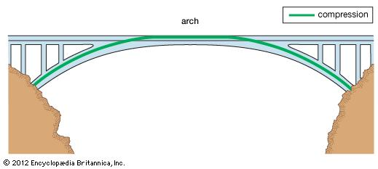
The overarching question
Motivates a body of research (a set of studies undertaken over time by an individual, group, organization, or field, where any one study is informed by the findings of earlier ones, such that progress is made)
Not always articulated in the research publications!
Important or not?

Slide 4

Importance of overarching questions
Provide motivation for a single study
Useful in tying separate studies together
Helpful in summarizing your own work
Can focus the work of a research center
Can speak to significance of a field’s endeavors

Slide 5

My own research
Q1: Why are information systems used or not?
Q2: Why do information systems require so much maintenance?
Q3: Why do some information systems innovations diffuse widely, while others do not?
Really interesting questions, o.k., maybe not to everyone

Slide 6

Question forms
What…
How…
Why…
Can…
Which…
Should…
Many forms. Which does yours take? Why-questions lend themselves to theorizing…

Slide 7

Overarching question criteria
Should be readily understandable by a wide audience.
Should have implications for practice.
Should be interesting.
Should be answerable at least in part by a program of research.

Slide 8

Overarching Q1
Why are information systems used or not?
  Early MIS which provided for online database inquiry from terminals often went unused by managers.
  I undertook a study of one such system.
  Conjecture was that appreciation of the system founded in a priori involvement in its development would lead to its use. Supported by the study. (Swanson, 1974)
  Other studies followed.

Slide 9
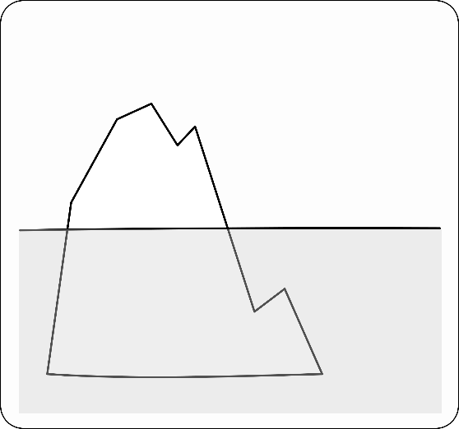
Overarching Q2
Why do information systems require so much maintenance?
  Many IS departments reported that more than half their staff was allocated to maintenance, rather than new system development.
  I undertook (with Ben Lientz) a survey study designed to explore why. A finding was that maintenance typically included substantial informal enhancement. Maintenance was perfective, not just corrective or adaptive. (Lientz and Swanson, 1980)
  Other studies followed.

Slide 10
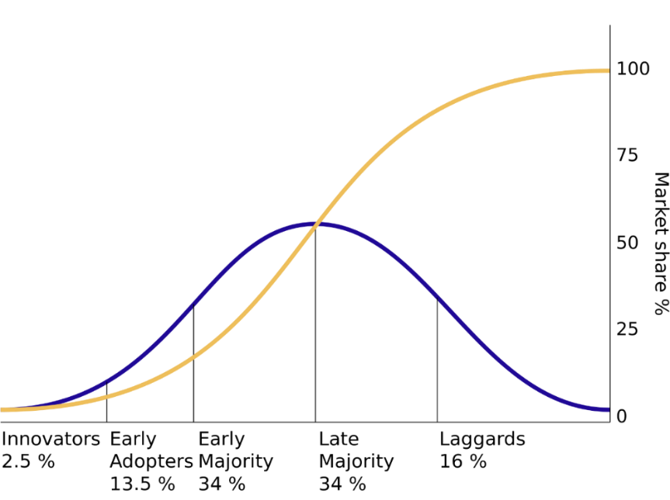
Overarching Q3
Why do some IS innovations diffuse widely while others do not?
  IS practice seemed to always chase the Next Big Thing. Managerial attention was often intense, but fleeting. While some IS innovations diffused widely, others failed to catch on and did not.
  Innovation theory was relatively well developed, but not yet particularized to IS. It also did not explain well different diffusion outcomes.
  I undertook to develop some IS-specific theory.

Slide 11
Follow the buzzwords!
Why so many in the world of IT?
Is there substance here or just so much noise?
Web services!
ERP!
Knowledge management!
CRM!
Business intelligence!

Slide 12
Making sense of the buzz
Ref: Ramiller, 2001
“…they jumped into it, because it was the latest and the greatest craze at the time and they figured they had to sign up for it, too …and, ‘We’ve got to go in and we’ve got to do what everybody else is doing,’” -Consultant
“… and I keep waiting for a silver bullet, a magic formula, an answer to all my prayers, and it never happens!” -IS manager
“In today’s business world you really have to grab right at the money. Profit before taxes, cash, cost reduction. We’re gonna take a building and close it, because of this technology. We’re gonna reduce our administrative staff. I mean, hard core numbers.” -IS manager
“I think [data warehouse] is a well-worn concept, and I think a whole lot a people thought it was a good idea 30 years ago. So, yeah …it’s a 30-year-old concept with a different name. It’s sort of a rose by any other name.” -IS manager
“… you see if it has meaning, you know, as you understand it. Would it help your organization, would it help certain areas of your organization, where might it help, what are the benefits of it? …you really need to drill down, in terms of what these concepts are, and what it means from an implementer’s point of view, and what it can mean to your business.” -IS manager

Slide 13

Conjecture
Buzzwords are important to understanding much IS innovation.
They serve to call attention to the idea of the innovation.
  Recall that an innovation is defined as an idea, practice, or object new to the organization adopting it
The idea of the innovation is central to its adoption, implementation, and diffusion
  But it is problematic!

Slide 14
Organizing vision
Ref: Swanson and Ramiller, 1997
A focal community idea for applying new IT in firms
Typically identified by a buzzword
Defines the innovation in broad strokes and is the basis for its comprehension
Produced by and sustained through the community’s talk about it (e.g. at trade shows and in trade press)
Provides for interpretation (what is it?), legitimation (why do it?), and mobilization of entrepreneurial and market forces (in providing requisite products and services)
Drives and is driven by the innovation’s adoption and diffusion
Has a characteristic “career” (in terms of its visibility, prominence, and influence over time)
Illustration: Enterprise Resource Planning (ERP) in the 1990s, as first articulated by the Gartner Group

Slide 15
ERP’s career
Ref: Swanson, 2003
“Recent events in hardware, operating systems and applications are crystalizing (sic) our definition of Enterprise Resource Planning systems-- the Next-Generation MRP II.” (Wylie, 1990)
“Here comes SAP!” (Fortune, 1995)
“What’s all the buzz about? Simply put, R/3 seems to be a case of the right product at the right time.” (Xenakis, CFO, 1996)
“The growing number of horror stories about failed or out-of-control projects should certainly give managers pause.” (Davenport, HBR, 1998)
“As 1999 winds down, it seems ironic that enterprise resource planning (ERP) has again attained almost the same dubious status it had when the acronym entered the lexicon in 1990- that of an idea that would never work.” (Keller, Manufacturing Systems, 1999)
“(I)t becomes clear the enterprise resource planning strategies were really designed to get the corporate house in order.” (Connolly, Computerworld, 1999)

Slide 16
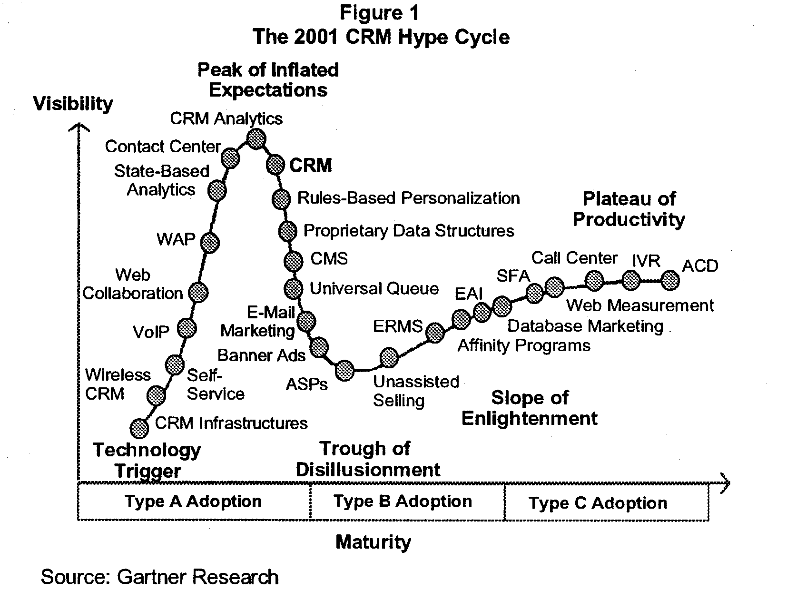
Gartner’s hype cycles
Ref: Nelson, 2001
CRM at the height of inflated expectations, with disillusionment soon to set in

Slide 17
The wave complex
Ref: Swanson, 2012
A myriad of opportunities to study and better understand IT innovation diffusion, e.g., regarding globality, does geography matter?
Cumulative attention (to organizing vision)
Cumulative adoptions
Cumulative implementations
Cumulative value added
t*
t**
t***
time >

Slide 18

Five studies
Q3.1 How is an organizing vision received?
Q3.2 How is a career launched?
Q3.3 How is momentum sustained?
Q3.4 How is value achieved?
Q3.5 How is widespread attention gained and held?

Slide 19

Innovation comprehension
Ref: Ramiller and Swanson, 2003
How is an organizing vision received?
Study (1994-96) combined field interviews with survey (143 respondents)
  sample item: “The company that waits to do X is going to fall dangerously behind.” (agree-disagree)
  45 items
Examined reception of three visions in different stages of their careers:
  E-commerce (early ascent)
  Client server (late ascent)
  CASE (descent)
Identified the dimensions of reception:
  Interpretability
  Plausibility
  Importance (business benefits, practical acceptance, community interest)
  Discontinuity
A finding:
  To the extent an organizing vision is ascendant (in discourse), it is received as important

Slide 20
How is a career launched?
Ref: Wang and Swanson, 2007
How is early momentum toward wide adoption achieved?
Conjecture: institutional entrepreneurship plays crucial role
  Self-interested actors leverage resources to create new institutions or to transform existing ones
  Mobilization and legitimation activities are undertaken
Case study: Professional Services Automation (PSA)
  Enterprise software purported to help service-oriented organizations manage their projects and employees, 1998-
  Actors included IT research firms, software vendors, consultancies, conference firms, trade publications, and universities
Findings: institutional entrepreneurs are challenged to:
  Develop and recognize leadership in the innovation’s organizational community.
  Facilitate or persuade community members to focus their attention on the innovation.
  Develop a coherent organizing vision for the innovation.
  Incorporate definitive success stories from users and vendors into the organizing vision for the innovation.
Alas, this was not accomplished in the case of PSA

Slide 21
Bandwagon building
Adoption dynamics
Rate of adoption rises, then falls
Extent of adoption among potential adopters is uncertain
  Important for network effects
Rapidity of adoption is also uncertain
  Important for drawing attention to the innovation
Bandwagon can be created where innovation becomes a management fashion

Slide 22

How is momentum sustained?
Ref: Wang and Swanson, 2008
Momentum in adoption allows bandwagon participants to ride and exploit it
Consultancies are drawn in, in particular to help with implementation, lessons are promulgated
Case study: Business Week’s special advertising sections on CRM (nine published, 2000-2004)
Findings: Participants acted to both exploit and extend CRM’s momentum
    Serialized content
    Accentuated evolution and progress of CRM
    Identified promising new developments to keep CRM vision fresh and responsive

Slide 23

Assimilation
How is value achieved?
Research suggests that upon implementation of new IT, firm performance may initially suffer (see, e.g., Ross, 1998)
Firms must learn how to use new IT
  Training is important, but does not suffice
  Situated learning by doing is required
  Workers must learn how to use new IT not only individually, but also collectively
With experience, firms are able to assimilate new IT into reconstructed work practices and organizational routines such that new capabilities are achieved
Yamauchi and Swanson (2010) studies one firm’s problematic assimilation of CRM across multiple locations, finding that routines are built by means of “familiarity pockets” outside of which system functionality can be ignored

Slide 24
Wikipedia study
Ref: Gorgeon and Swanson (2013)
How is widespread attention gained and held?
Five-year history of Web 2.0 entry in Wikipedia
Reveals the capture of an organizing vision
Wikipedia as a new encyclopedic form
What is Web 2.0?

Slide 25

Summing up
How is the organizing vision concept useful?
Provides a theoretical lens for answering Q3: Why do some information systems innovations diffuse widely, while others do not?
Offers a broad perspective within which to position both new and familiar research on adoption, implementation, and use.
Enables the development of a historical perspective in the information systems field.

Slide 26

Overarching questions revisited
A reminder: have you sent me yours?
Are we persuaded that such questions can be useful?
Any questions about overarching questions?

Slide 27

Added thoughts
Overarching questions
Can be imputed after the fact, and may also be disputed
Are not necessarily specific to a field
May be enduring or not
Can characterize research as a practice

Slide 28

Lastly
Imagine that you have just encountered your Dean in the elevator.
He or she asks you, “What’s with your research? What question are you trying to answer with it?”
Are you now prepared for this?
I hope so! Thanks for the invitation to join you in Edmonton!

